Slide 1
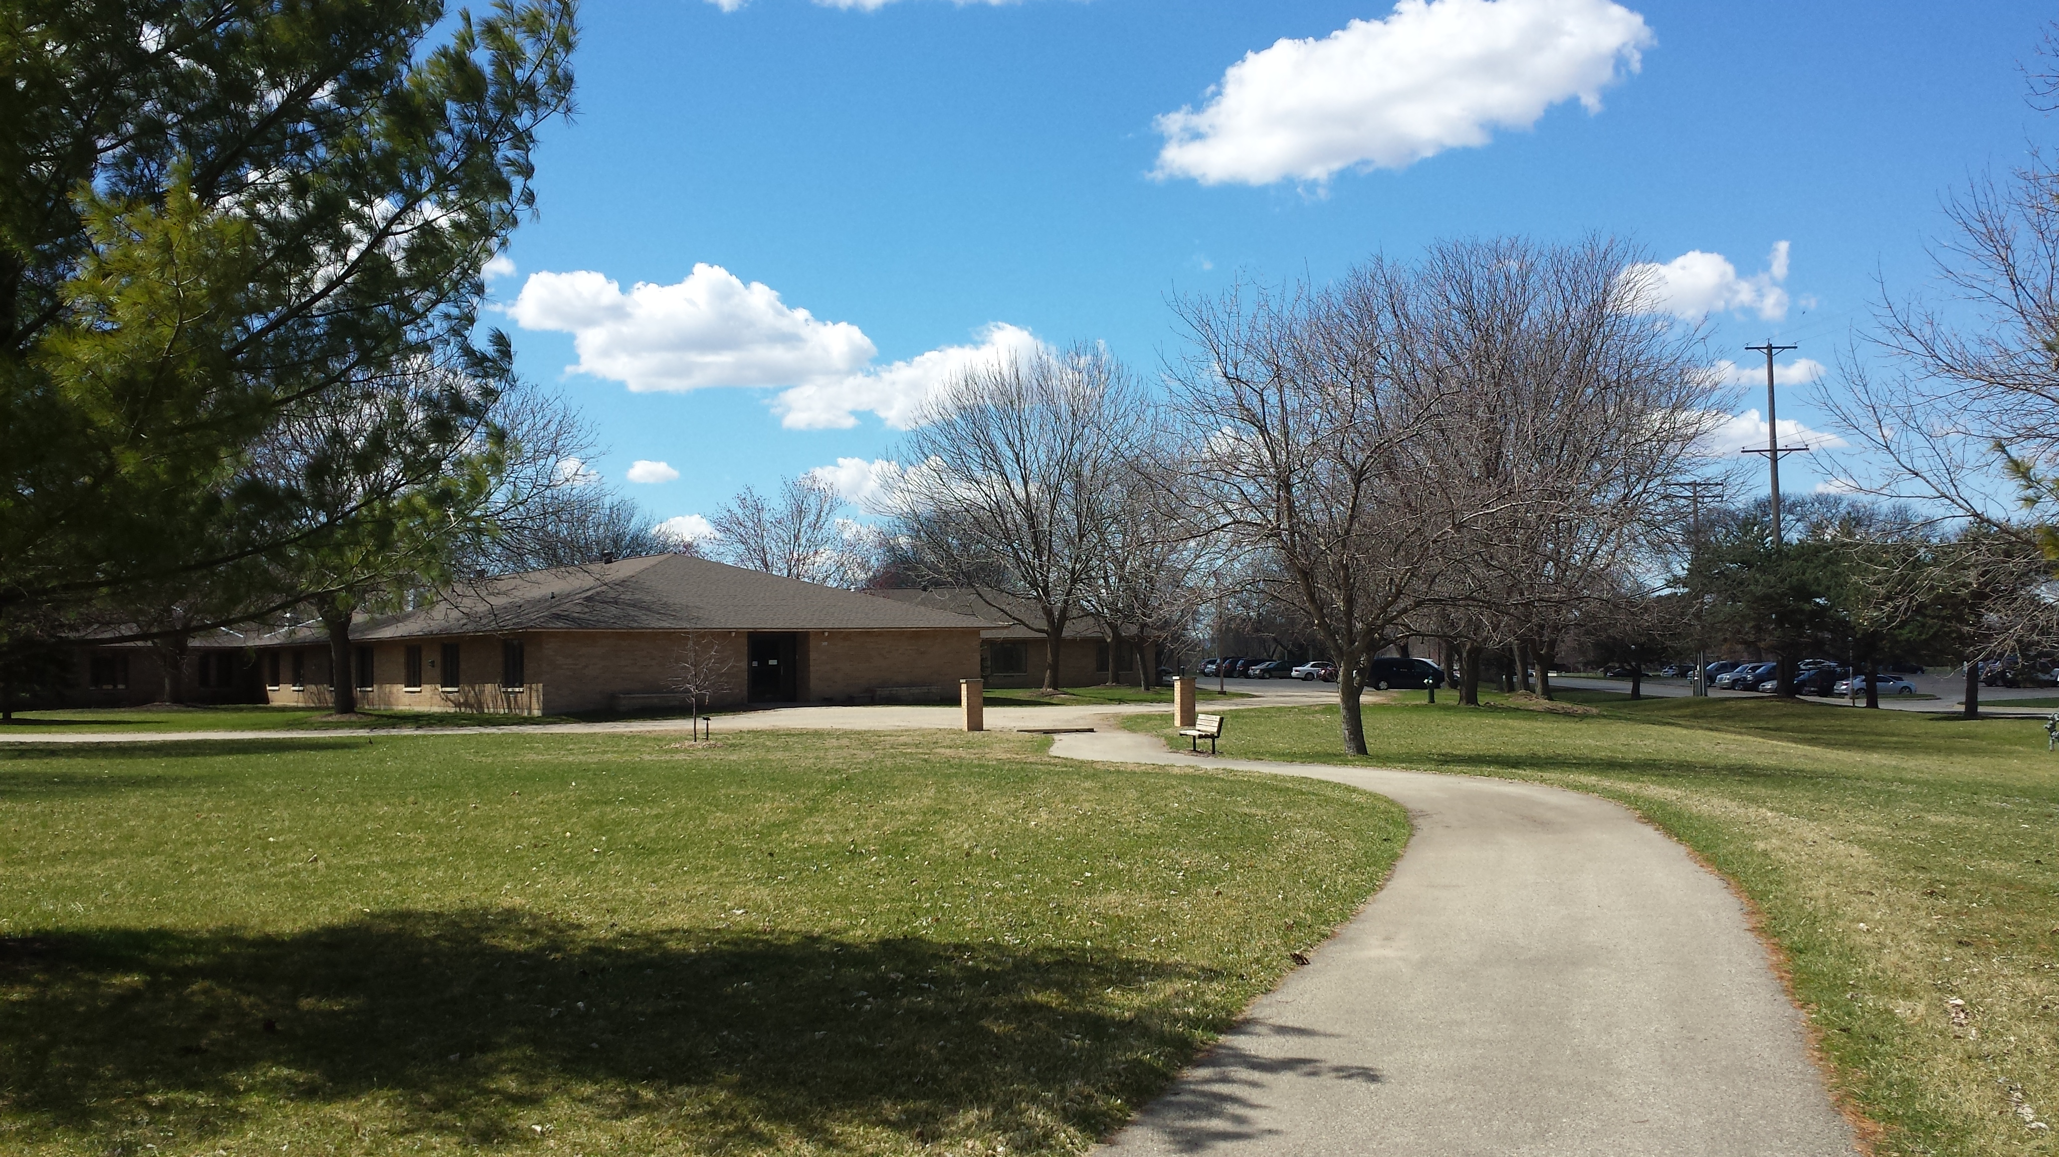

TOWN HALL
August 2025

Slide 2
Hillview Nursing Home
West side of building
A new spa opened on the 600 hallway. Staff are using it to bathe residents. New lighting, heating element, aromatherapy and music will be additions to this experience.
The Recreation Room is our temporary Therapy room.
Volunteers can pick up name badge and sign in/out in Kim’s office on 600 hall.
The second new spa will open September 12th on the 800 hallway. This space will also have a sink for hair washing and space for Karla our stylist to work temporarily until the salon on 600 opens.
Update to

Slide 3
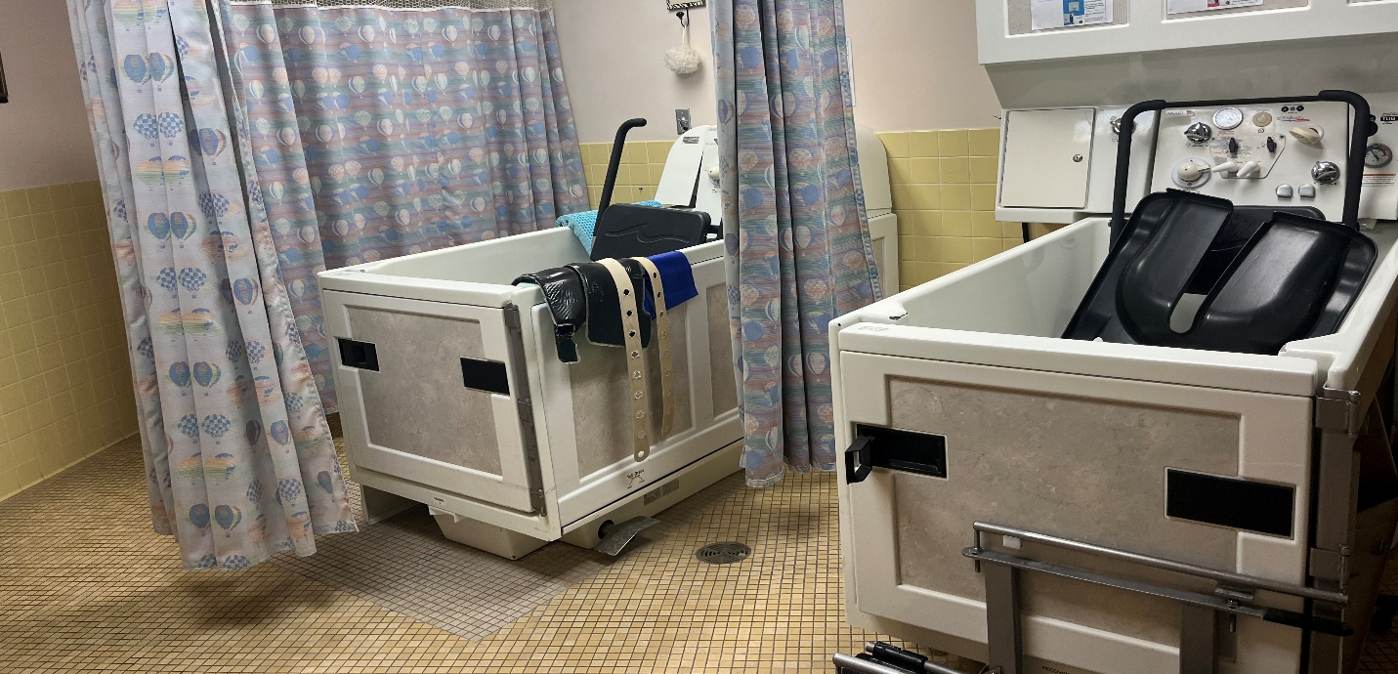

Slide 4
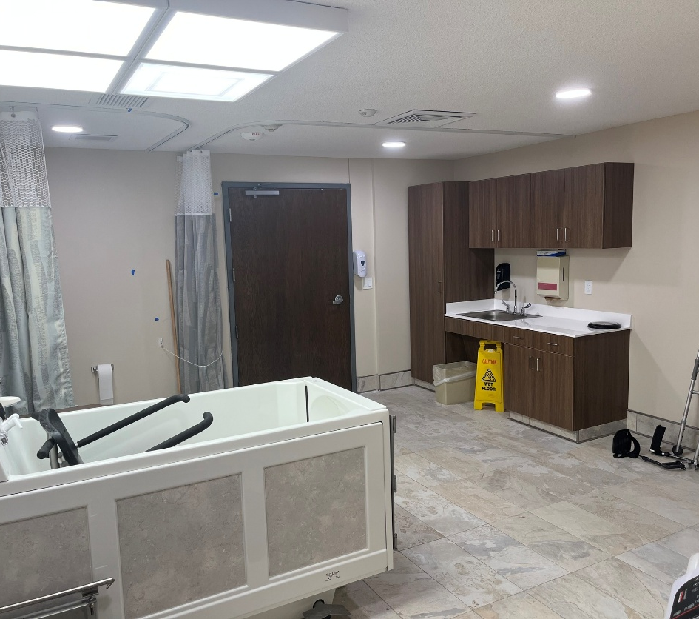
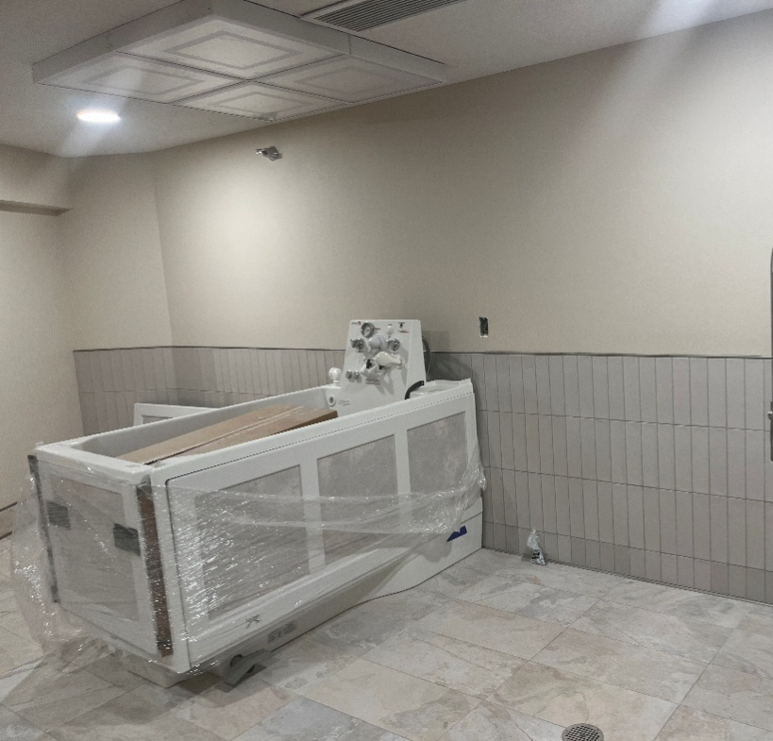

Slide 5
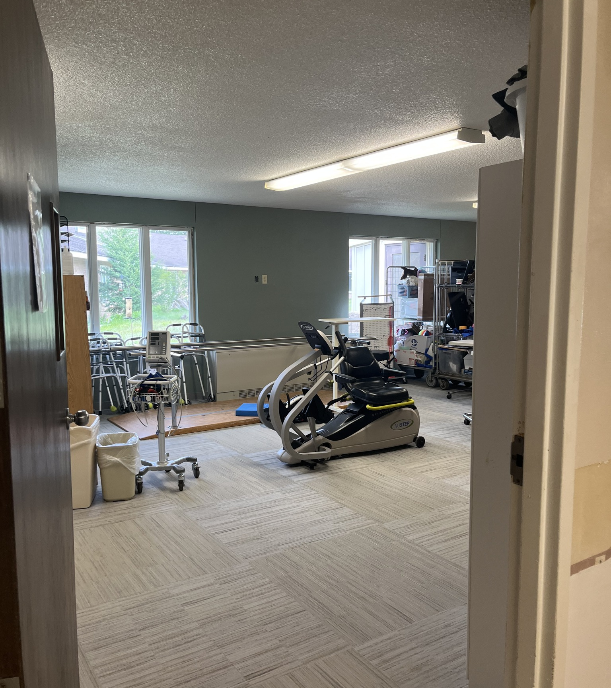
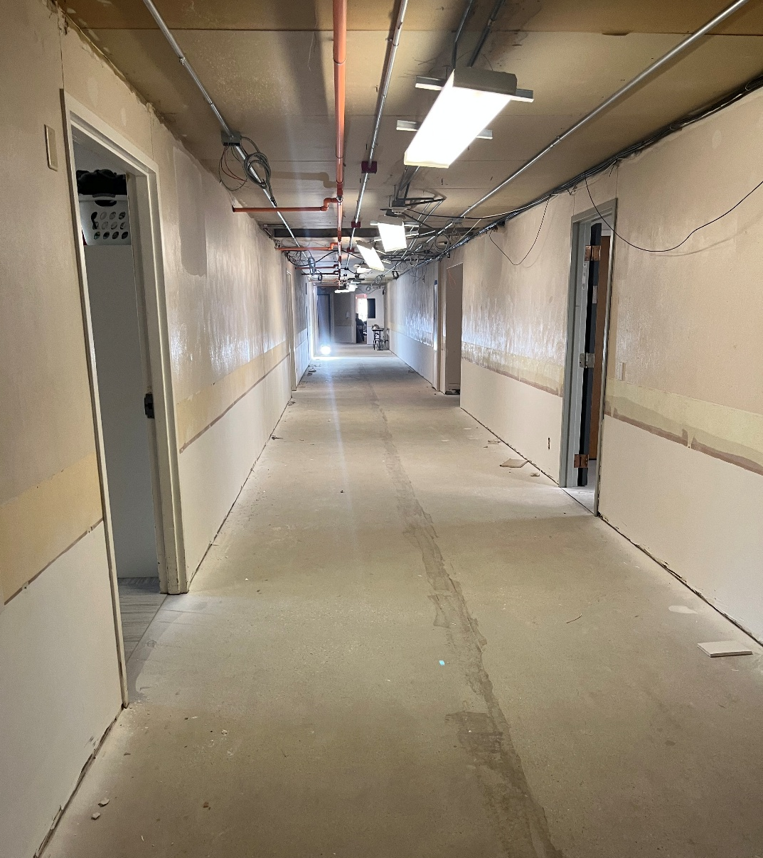

Slide 6
OTHER UPDATES:
The Oaks reopened
September 1 heating and cooling transition will occur; resident should not notice any change.
New asphalt in our front parking lot and stripping is complete at CH, HV and HVT.

Slide 7
Front Desk Space:
September 17 front desk remodel completion will be surveyed by DHS for occupancy. Staff can begin to relocate to their front area offices from the 600 hall whose final space is in this area on September 22..
Some areas will look the same.
The front desk will look the same ; hoping for a facelift down the road.
One of the 2 bathrooms will be remodeled (women’s) both will be unisex bathrooms.
Most staff will need to share office space until the end of construction.
Signs will identify where staff are located.
Updates to Resident Spaces
Anticipate final occupancy approval next week. DHS here Wednesday and Thursday for walk through.

Slide 8

Tentative timeline for completion
CBRF/Housing/Life Center: November 2025
SNF will be extended to be completed March 2026

Slide 9
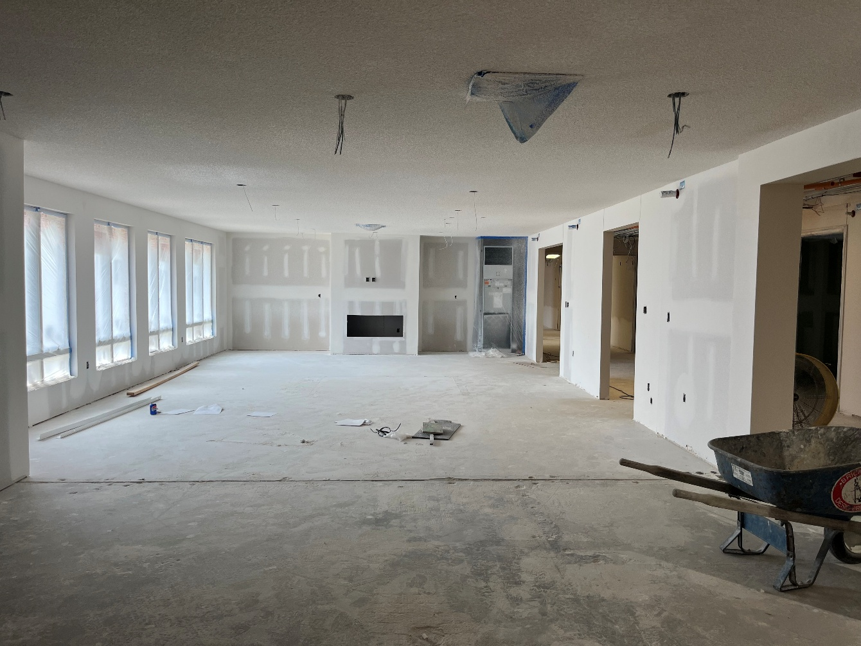
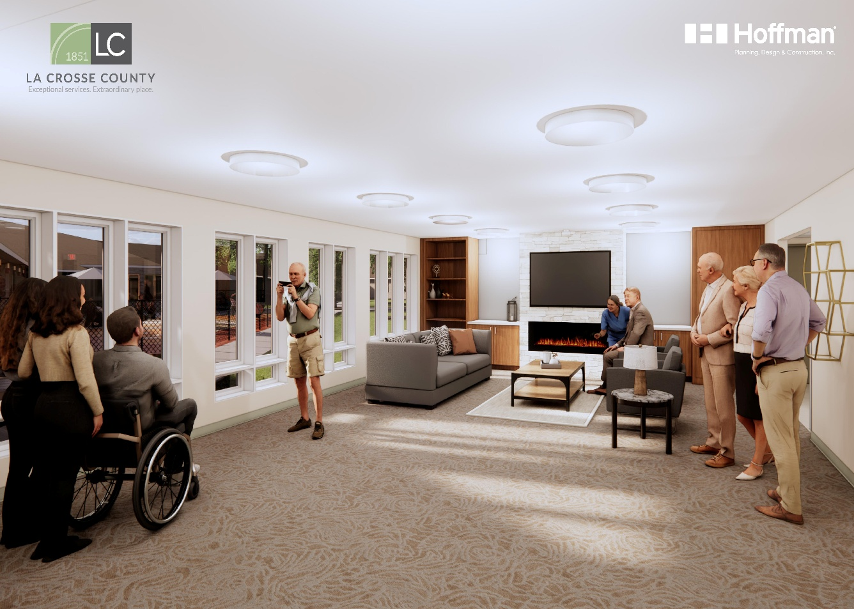

Slide 10
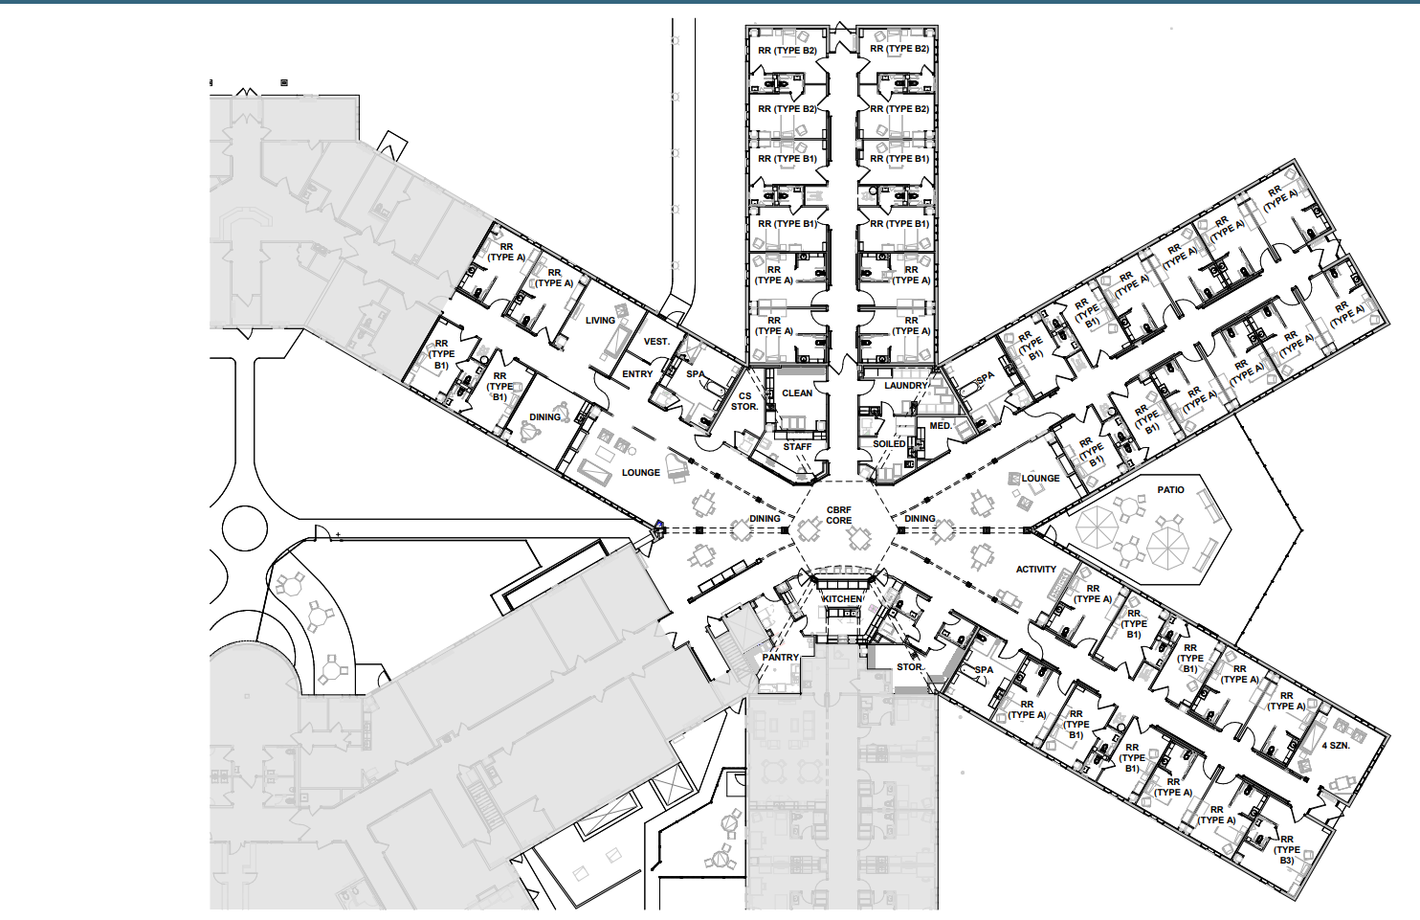

Slide 11
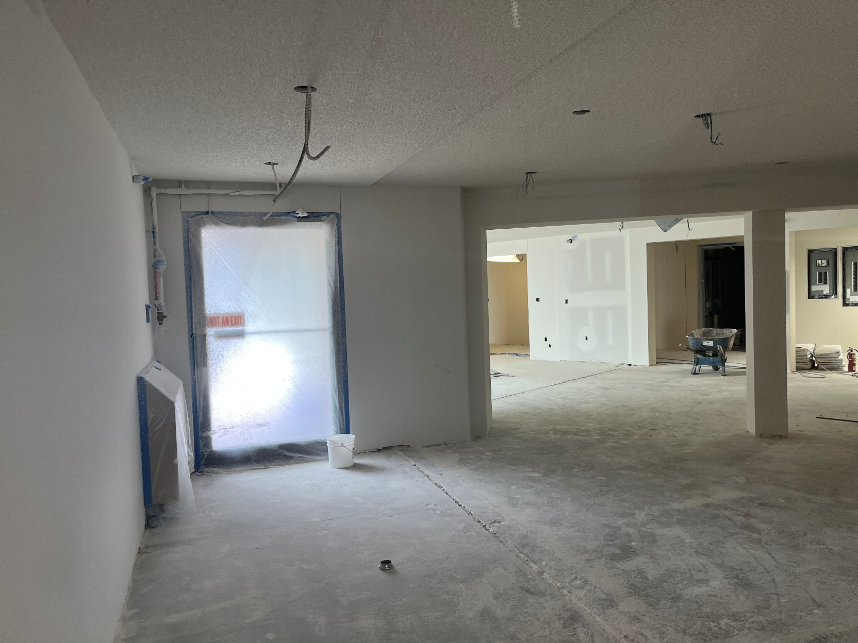
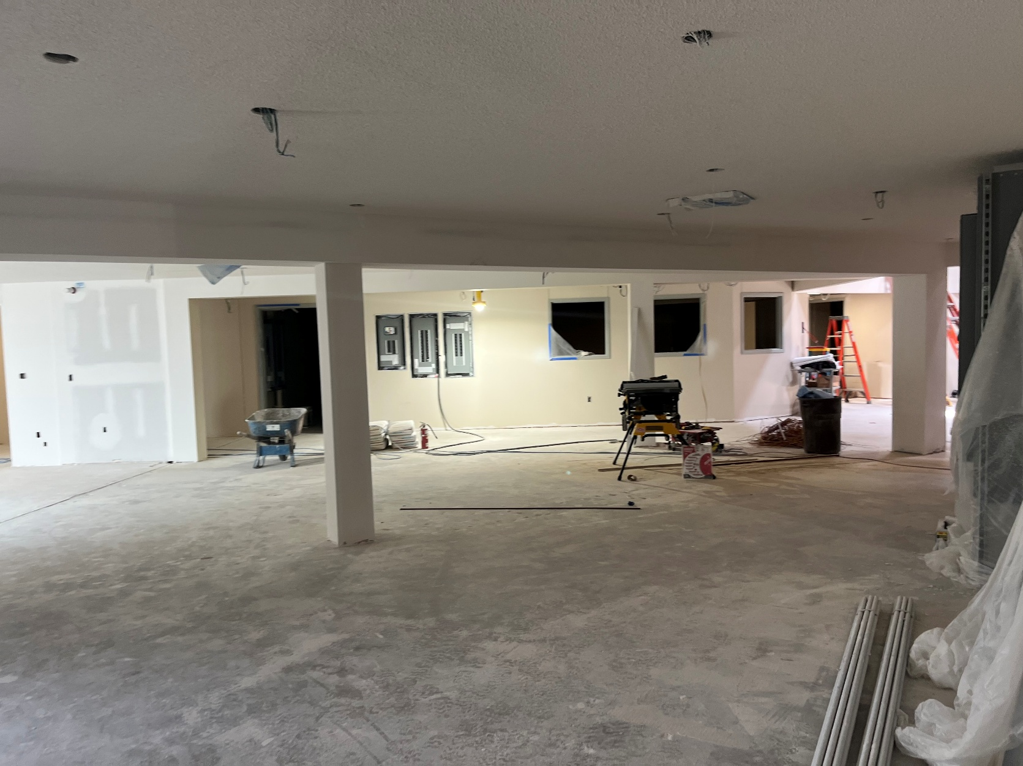
3 Dining Room Tables
Tover Interactive Table

Slide 12
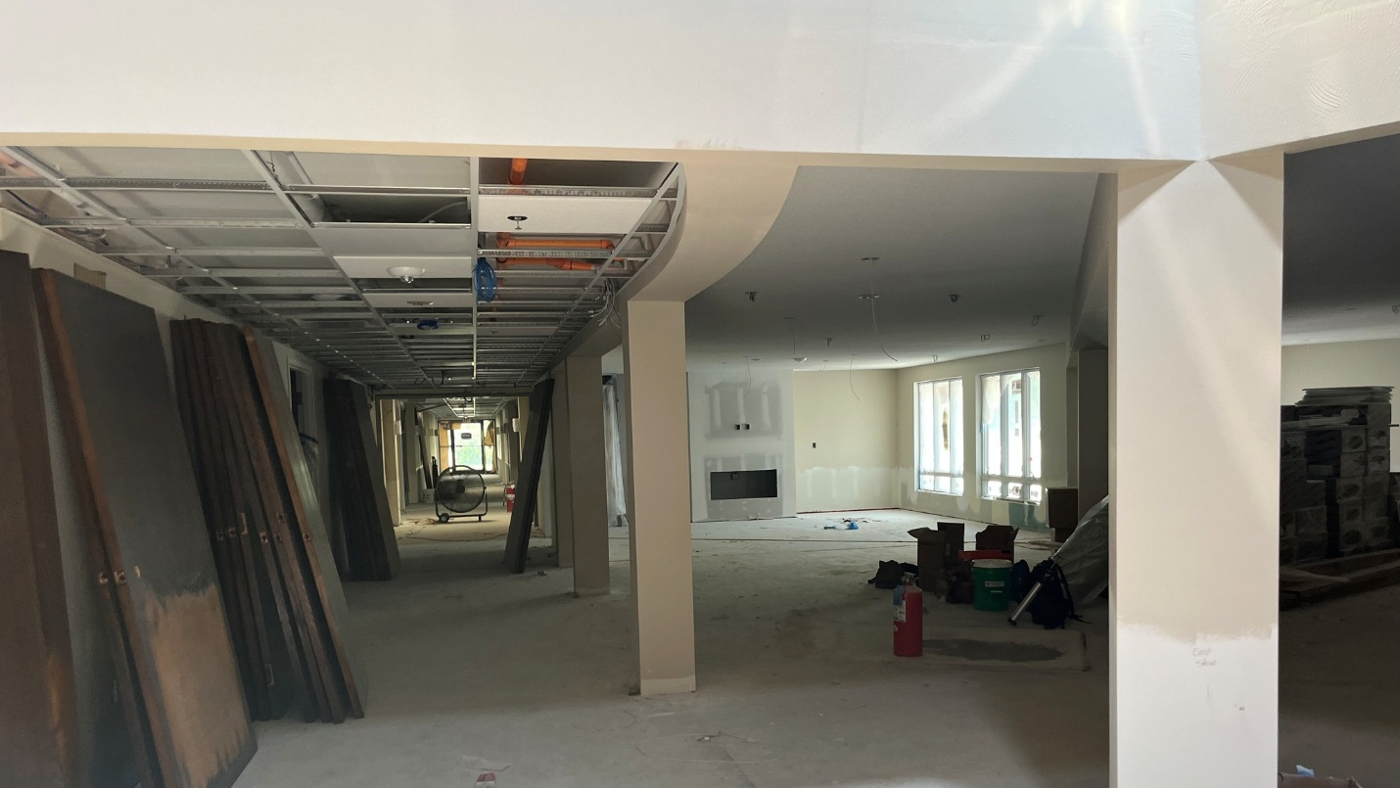
Family Room

Slide 13
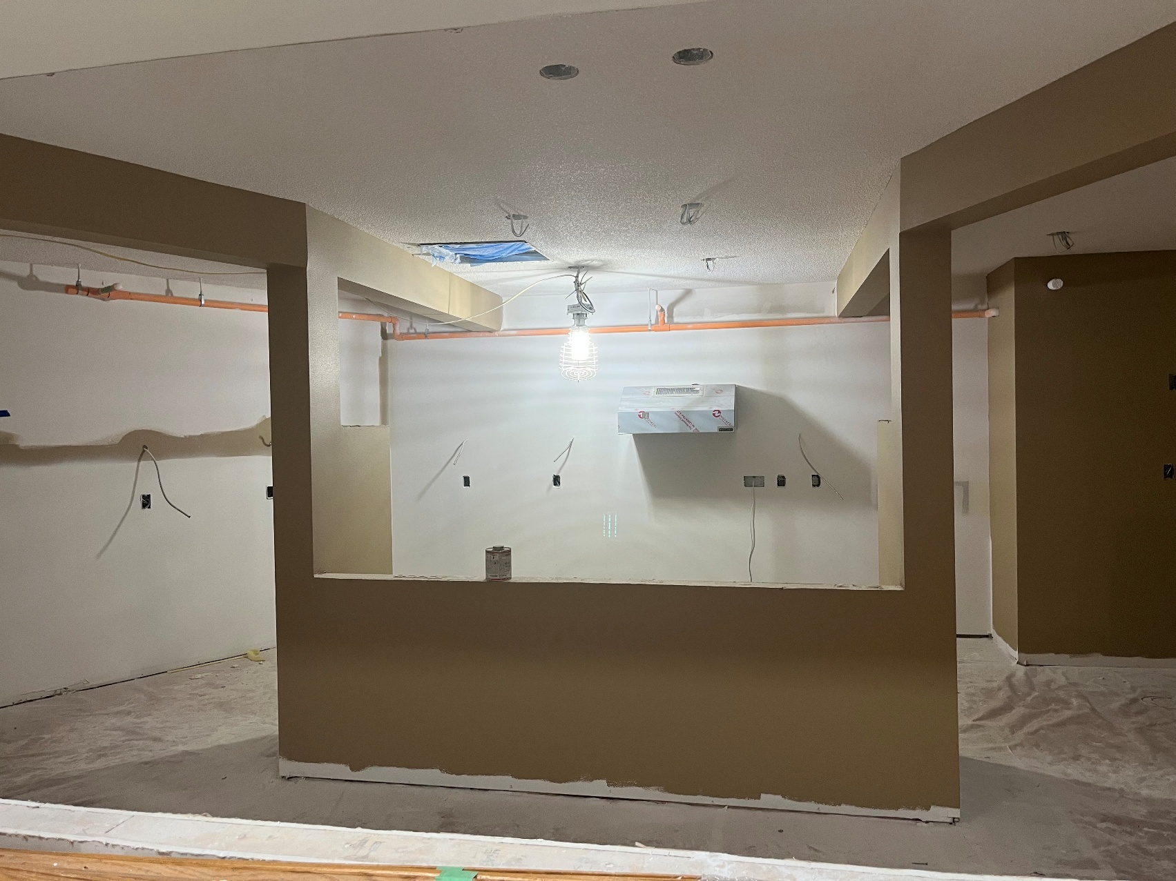
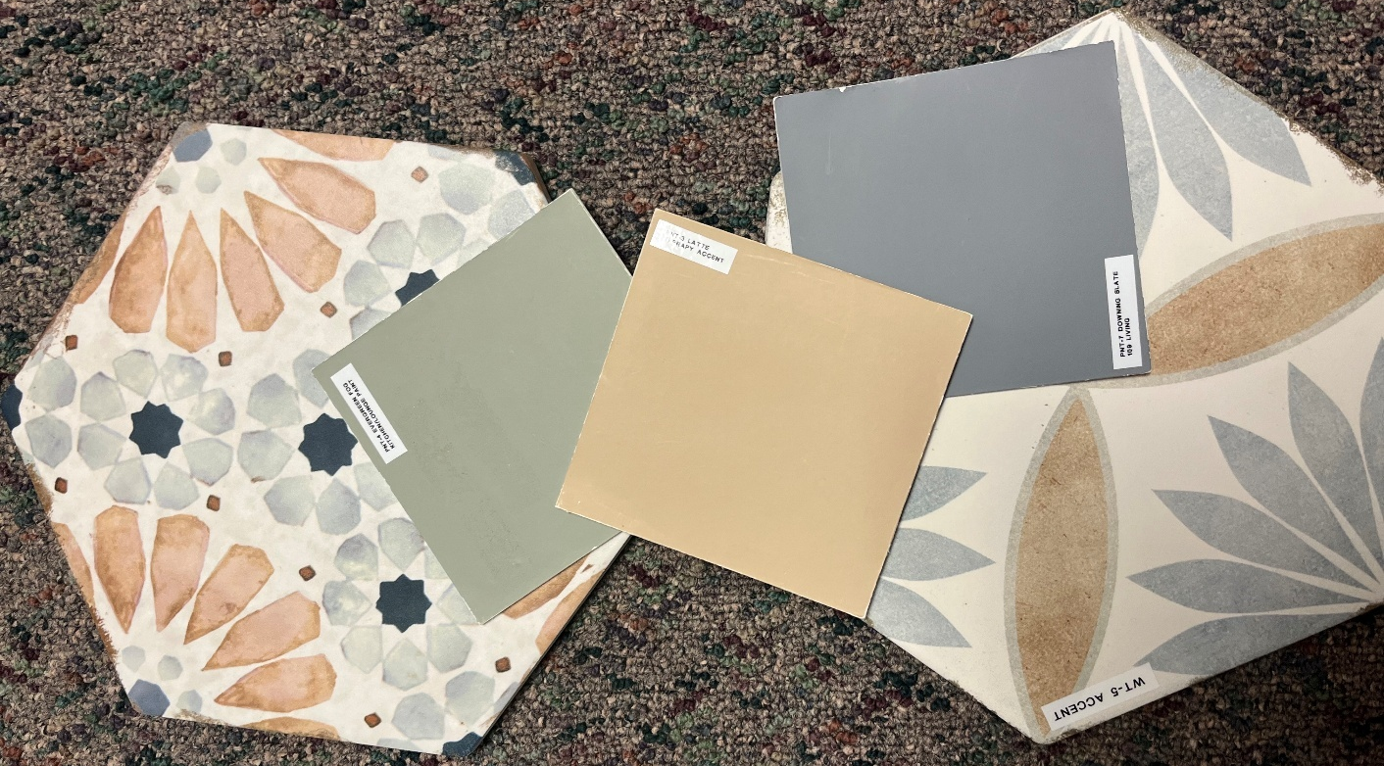
Colors in Evergreens CBRF serving kitchen
(left)
Evergreen’s serving kitchen
Colors in Hillview’s serving kitchen
(right)

Slide 14
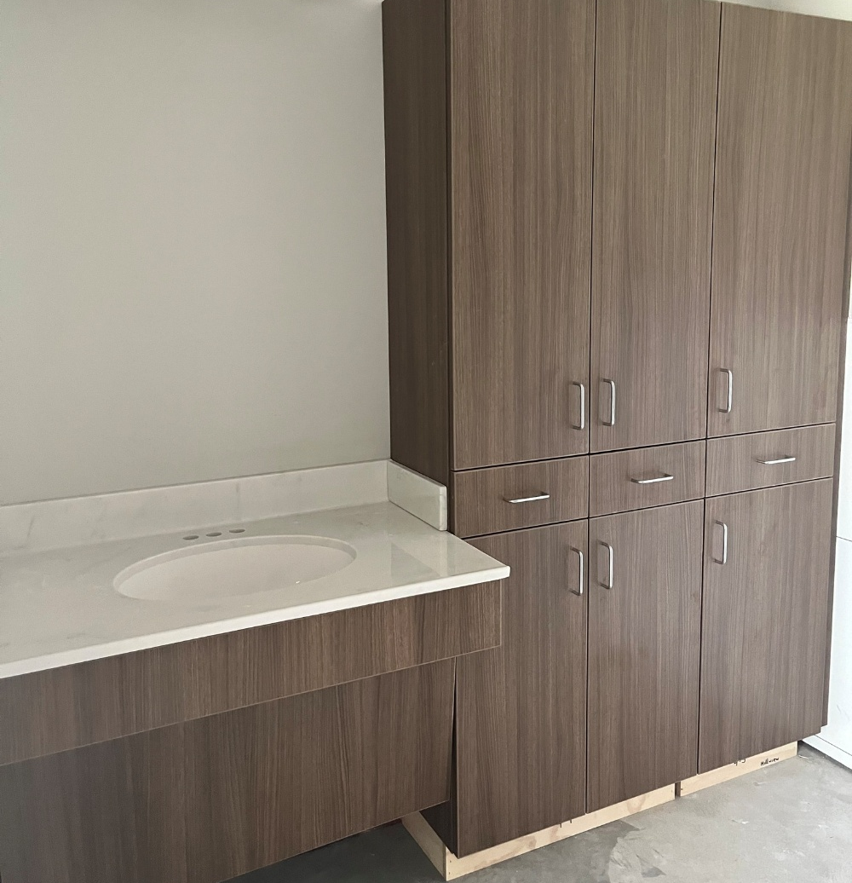
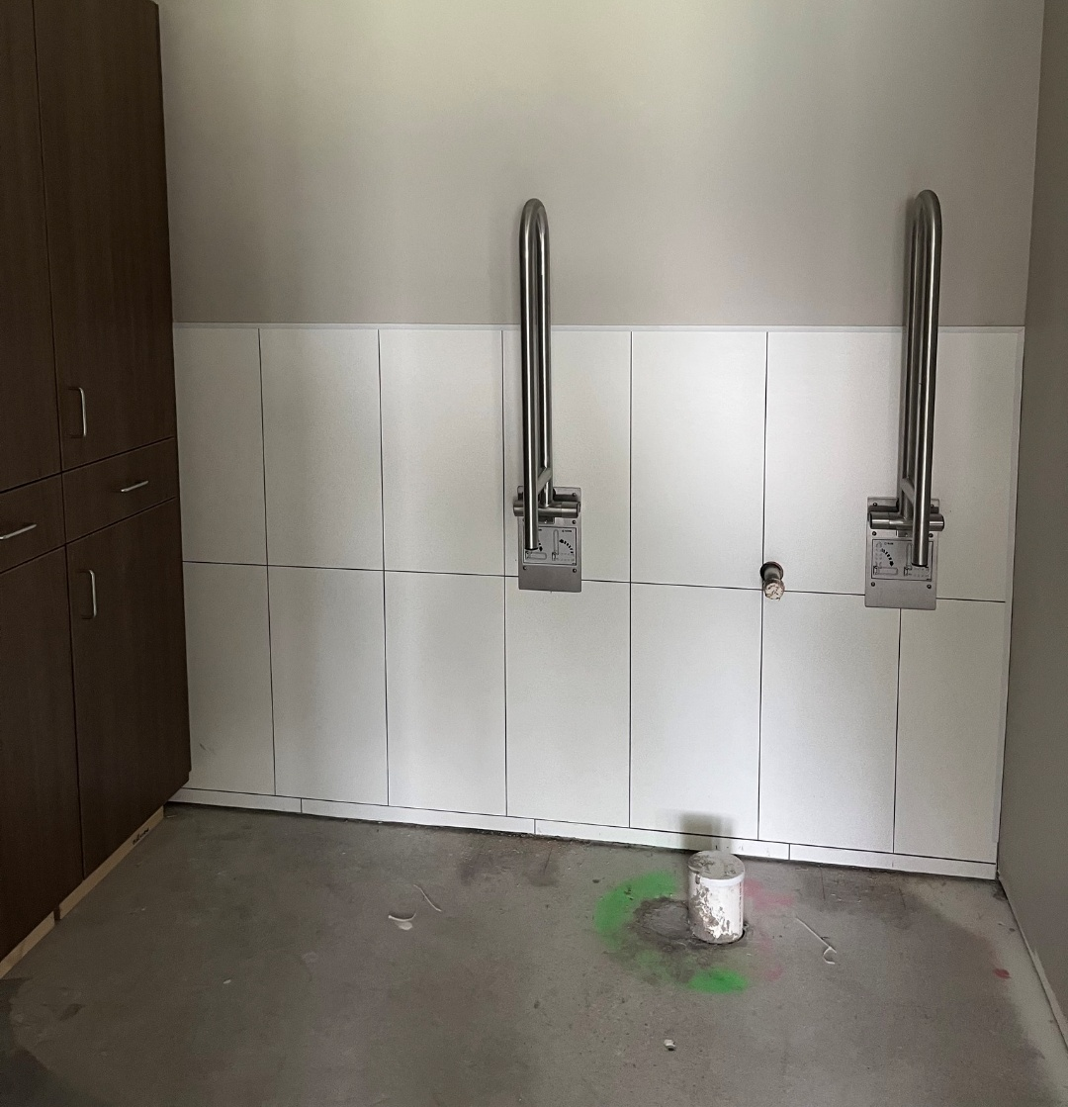
Evergreen’s ADA bathrooms

Slide 15
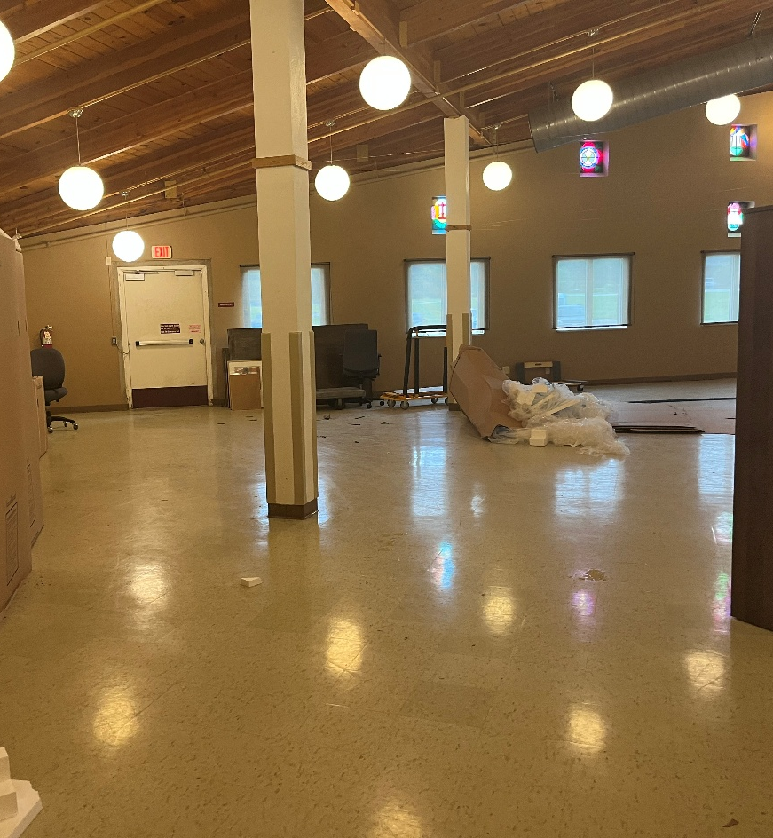
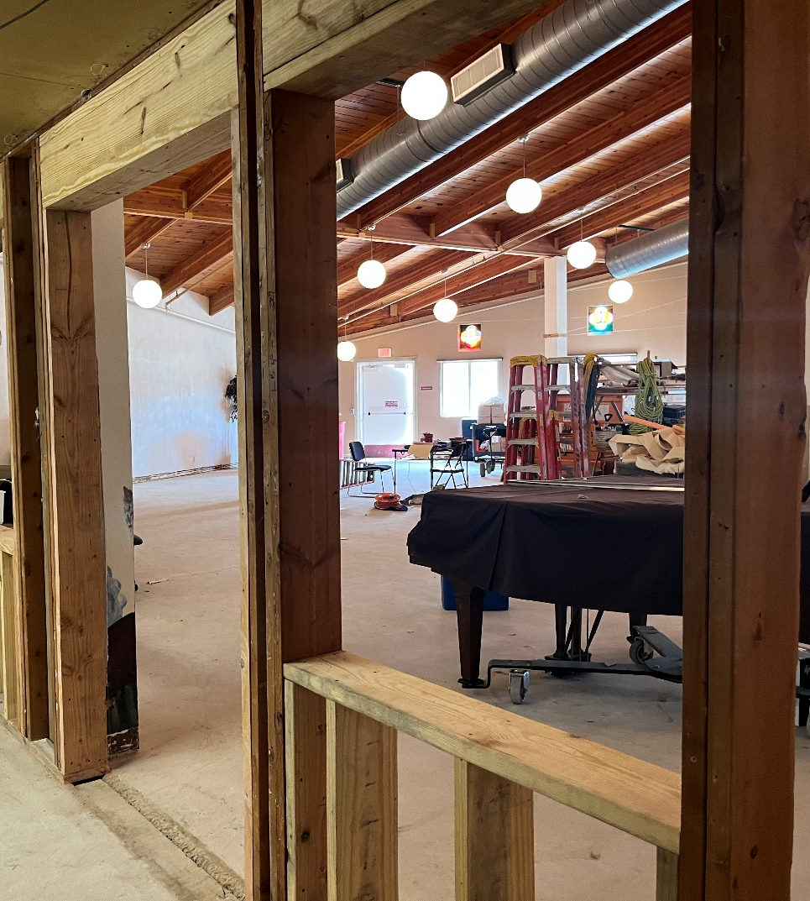
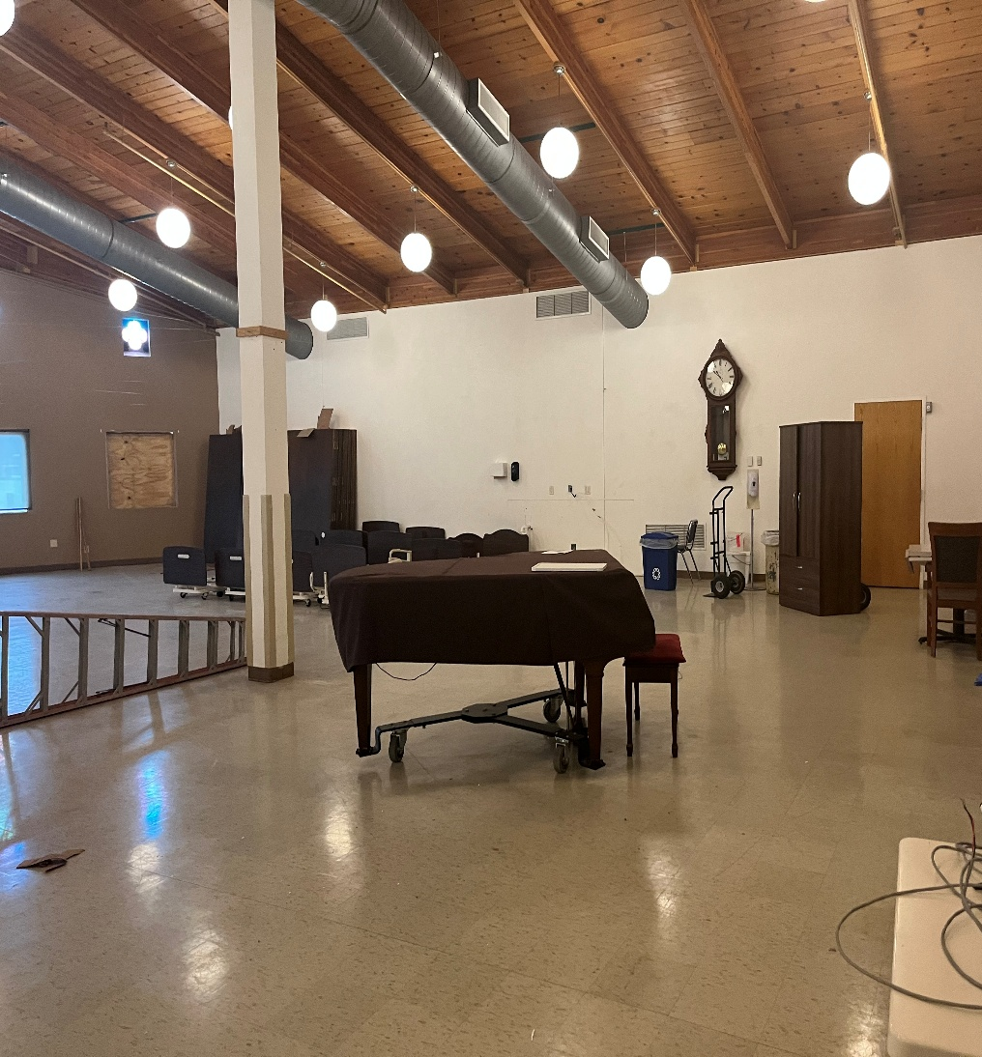
Hillview Campus
LIFE CENTER

Slide 16
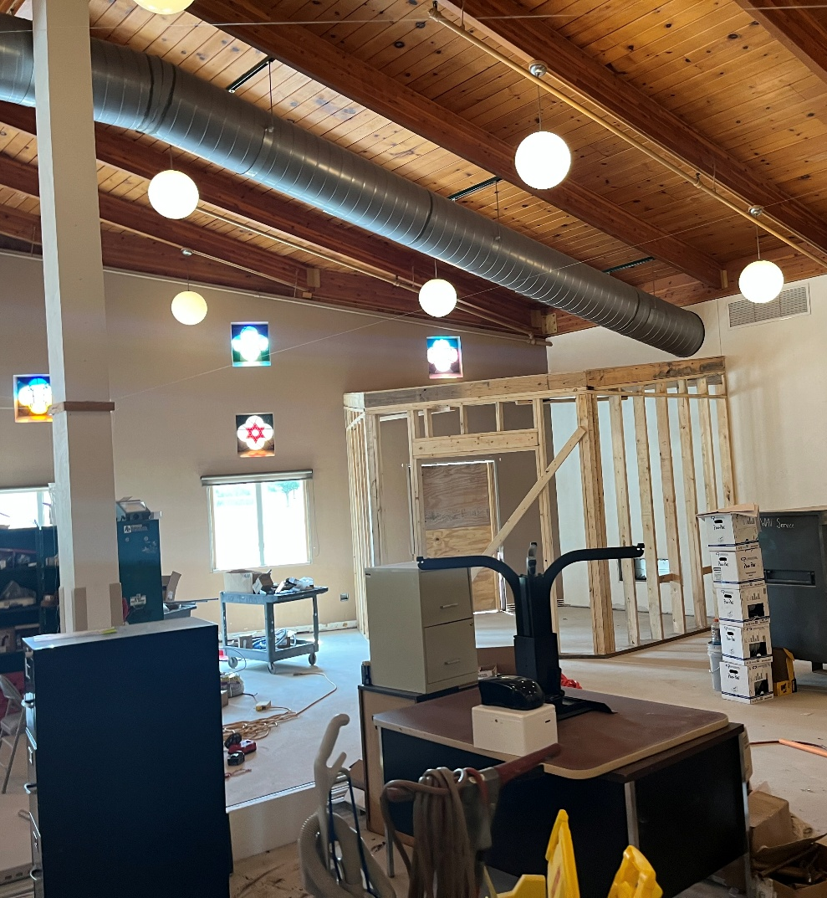
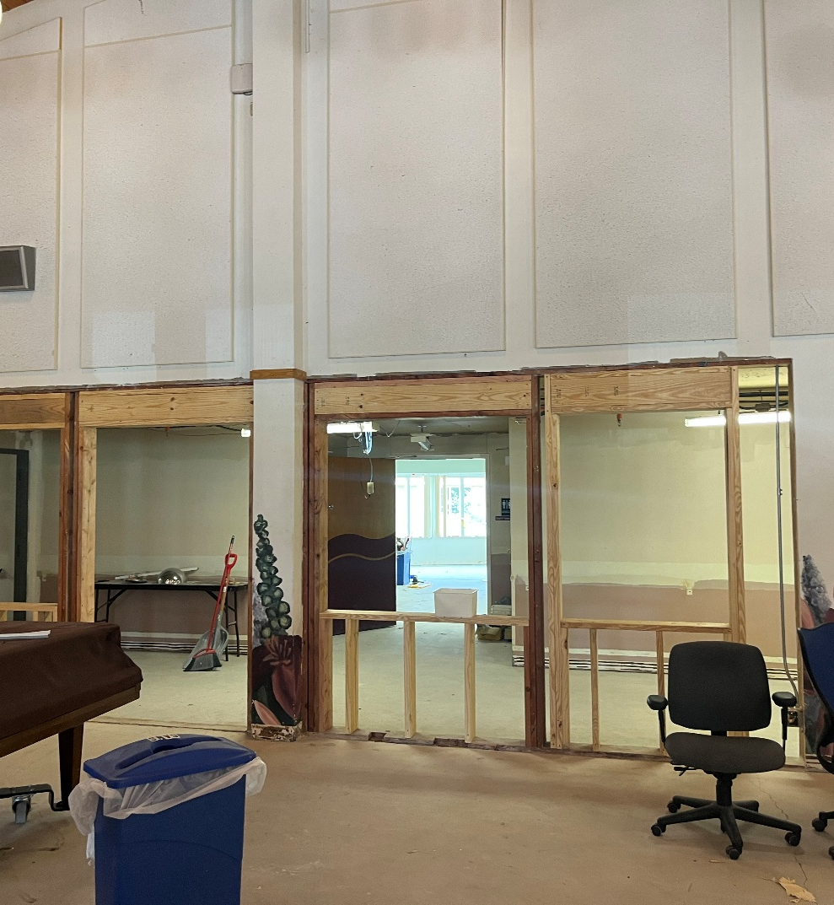

Slide 17
THANK YOU

