Slide 1


Pathways Home:
Building a system to end the City of La Crosse’s homelessness crisis
City of La Crosse Common Council & La Crosse County Board
September 8th, 2026
Notes:
Brian

Slide 2
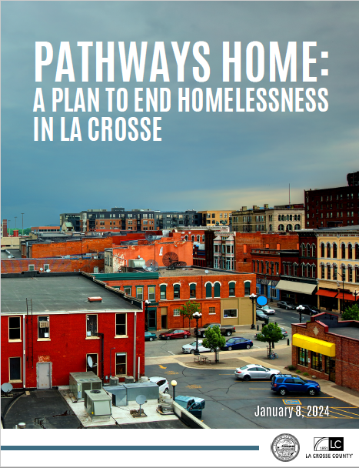
Pathways Home
Summary
● Five-year plan to end homelessness as we know it in the City of La Crosse that launched in January of 2024
● The initiative is led by the City of La Crosse and La Crosse County and includes a comprehensive and collaborative effort involving many community stakeholders
● The partnership between the City and County is co-equal with a focus on sustainability
Notes:
Brian

Slide 3
Concrete Goals:
● Zero individuals living on the street
● Homelessness functional zero
Key Elements:
● Local government coordination
● Resource & policy alignment
● Shift to indoor service orientation
- Outdoor living is not an option
- Laws on the books are enforced
- Local resources preserved for local residents
Notes:
Brian

Slide 4
We are not in this work alone!!!
Catholic Charities
City of La Crosse Fire Dept
City of La Crosse Police Dept
Couleecap
Coulee Tenants United
emplify HEALTH
Family & Children’s Center
First Free Church
Great Rivers 211
Independent Living Resources
Karuna
La Crosse County Health Dept
La Crosse County Veterans Services
La Crosse County Zoning,
Planning & Information
Landlord
Legal Action
Lived Experience Individuals
Lutheran Social Services
Mayo Clinic Health System
Next Chapter
New Horizons
New Beginnings Christian
Fellowship
RHYMES
Salvation Army
School District of La Crosse
State of Wisconsin Balance of
State Continuum of Care
Viterbo University
Vivent Health
WINN
YMCA
YWCA
Notes:
Brian

Slide 5
City of La Crosse & La Crosse County
Pathways
Home
Building a System to End the City of La Crosse’s Homelessness Crisis
PROJECT PHASES
PHASE #1
PHASE #2
PHASE #3
(2024-2025)
(2025-2028)
(2029+)
ALIGN THE SYSTEM
All the community’s resources are working together to support individuals obtain and keep housing
BUILD THE CAPACITY
(Create Shelter & Housing Capacity)
End outdoor living by assuring everyone has an option for either shelter or housing
SUSTAIN THE GAINS
- Complete and sustain the shift to serving people indoors by continuing to increase housing capacity while strengthening prevention and enforcing community norms
Notes:
Brian

Slide 6

I. Unsheltered Homelessness

Slide 7
Housing and Support Needs Differ Across the Homeless Population
Notes:
Brian
The concerns about our parks, library, and downtown are real. People are experiencing serious crises, and residents, businesses and people experiencing homelessness are feeling the effects. At the same time, our overall homelessness numbers are declining. Understanding how both things can be true helps us identify where our next investment needs to go.

Slide 8
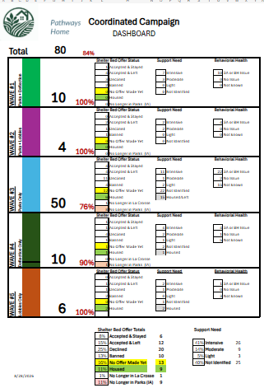
Pathways Coordinated Campaign
We are prioritizing shelter and housing for our highest need, highest community impact unsheltered population.
Our progress:
Our list has grown to 80 names, 84% of shelter-eligible individuals have received a shelter bed offer.
9 individuals have been housed.
20 individuals have been offered "pathways to treatment" package of Care Center-Residential Treatment-Sober Living-transitional living.
4 of those individuals are active in their treatment package.
Notes:
Jim
Downtown conditions required a different response.
This population drives substantial community costs and requires extra support and resources to get stable housing.
Voluntary nature of county services:
Most County offered service support programs are voluntary. We use motivational interviewing and other techniques to encourage participation.
Some individuals decline accepting emergency shelter or service offers.
As long as these individuals are not violating other laws or ordinances, they may remain in public spaces.
While this causes frustration from the community, there are constitutional rights and other legal protections that limit what interventions can occur.

Slide 9
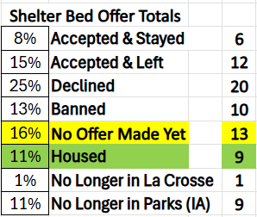
Pathways Coordinated Campaign
Shelter bed offer results to date:
40+ individual offers have been made
  ~50% decline the offer, we record the reason
  ~2/3^{rds} of those who accept the offer struggle to stay in shelter
Our current 24/7 shelter is a challenging setting for those with intensive support needs.
Treatment to housing package offers—results to date:
20 individual offers have been made
  20% accepted the offer, treatment package in process
  20% started the package, but left on their own, we record the reason
  60% declined the offer, we record the reason
Notes:
Jim
Story about JW

Slide 10
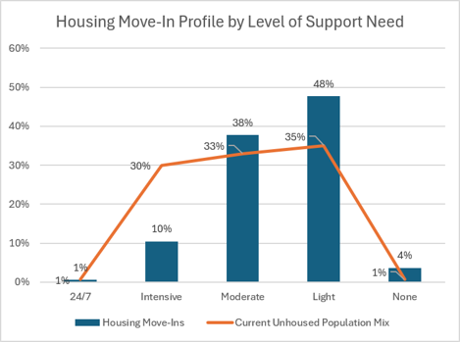
Good Progress with Light & Moderate Housing
Intensive Housing Placements are Difficult
Intensive (daily) Support Housing
30% of our homeless population
only 10% of our housing placements
Moderate (weekly) Support Housing
33% of our homeless population
38% of our housing placements
Light (monthly) Support Housing
35% of our homeless population
48% of our housing placements
Housing Placements Since January 2025
Notes:
Jim
Progress has not reached everyone equally.

Slide 11
II. Overall Progress
Notes:
Jim

Slide 12
Making Progress in a Challenging Environment
Ref: https://www.wicourts.gov/casesearch.htm
Notes:
Jim
Pathways Home is reducing overall homelessness.

Slide 13
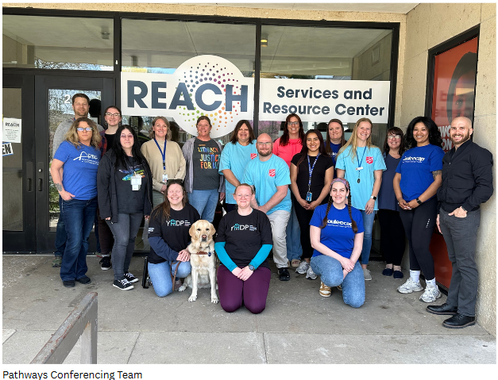
System Built & Aligned
System Coordination
General and targeted homeless outreach
Community shared by-name list
Weekly Pathways Case Conferencing: 12-15 agencies regularly attend
Pathways Adult Needs & Strength Analysis
Pathways dashboard
Notes:
Brian
Story about Pathways Conferencing (finding someone right away and offering them support because of conferencing)

Slide 14
Support Services Added
Pathways Specialized Unit
6 social workers and 3 peer support specialists
Medicaid Supportive Housing (1915i)
La Crosse County formed the Housing Support Services (HSS) unit & with 4 staff to manage >100 Medicaid approved prior authorizations.
Notes:
Jim
Pathways Specialized Unit
A unit of 6 social workers and 3 peer support specialists has been created within La Crosse County Human Services that specializes in providing case management to individuals transition to housing from homelessness. Plus 2 grant funded social workers.
Medicaid supportive housing
La Crosse County was one of the first counties in Wisconsin to launch Medicaid Supportive Housing services.
This program funds the following:
Housing consultation to develop a person-centered housing support plan
Transition supports such as help with applying for units
Sustaining supports such as conflict resolution & independent living skills
Relocation supports up to $2,000 for security deposit, utility activation fees, necessary health & safety services, & essential household furnishings.
$350,000 Wisconsin Department of Justice Deflection grant
Partnering with Police and our Justice System to break the cycle of homelessness-jail-homelessness through supportive services and housing support. 25 people are in our deflection program.
$102,000 City HOME ARP grant:
Funding a dedicated social worker to work with 10 of the highest need unsheltered population and launch County provided Community Support Services (CSP) programing—our highest level of support.
RISE (Opioid settlement funding) Synergy
We’re coordinating jail reentry & service support and housing support funds use with the RISE team.

Slide 15
Leveraging Grants to Extend Our Reach
$350,000 Wisconsin Department of Justice Deflection grant
$102,000 City HOME ARP grant:
RISE (Opioid settlement funding) Synergy
Notes:
Jim

Slide 16
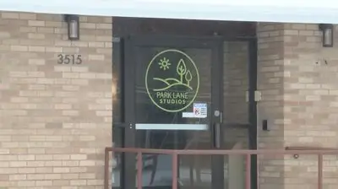
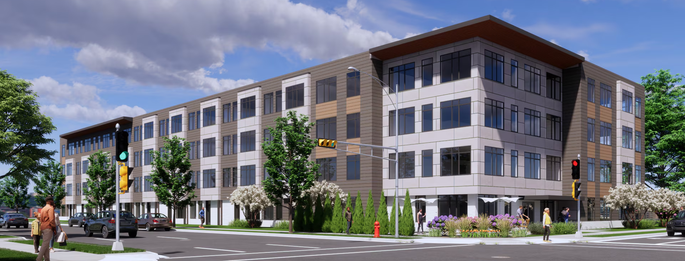
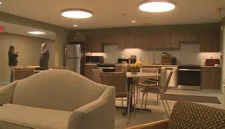
Specialized Housing Progress
Collective on 4th: 12 set aside units
Park Lane Studios: 10 units
Housing stability brings income growth
Notes:
Brian
Collective: 17 total households. 16 of 17 renewed leases.

Slide 17
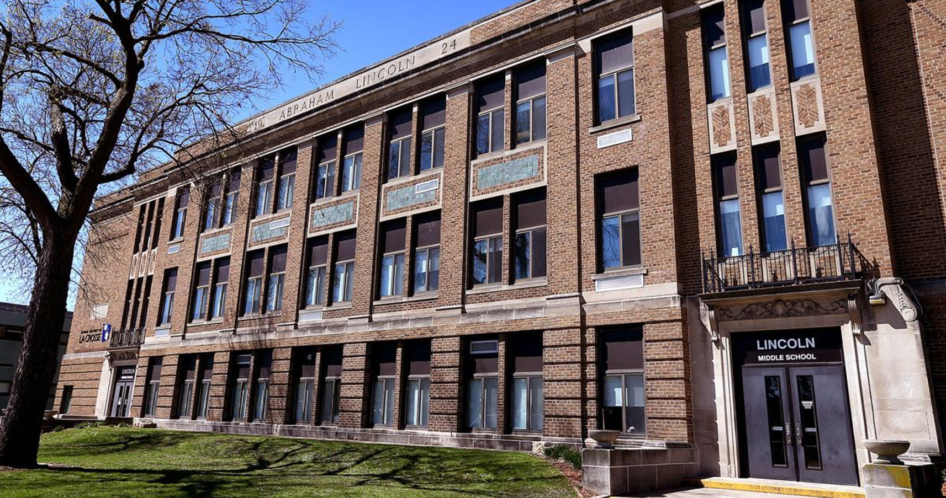
New City Housing Developments
Recently Completed Housing Developments
Market Rate Units | Income Eligible Affordable Units
War Eagle | Driftless Apartments
C&C Residences | Collective on Fourth
Badger West
Grandview Apartments
Lincoln Middle School – Future Development of 51 affordable units
Upcoming Housing Developments
Market Rate Units | Income Eligible Affordable Units
Chalmers (La Crosse Tribune building) | Haven on Main
Bridgeview Plaza | Heritage Lofts at Lincoln Middle
The Lofts at River Point District | Cinnaire 7th St Residences
Additional Development at River Point District | Copper Rocks*
*pending development agreement
Notes:
Brian

Slide 18
Pathways-Held Leases
Roles:
The City signs a lease with a landlord and then subleases the unit.
A tenant manager manages lease signings, rent collection & payment, & rental unit issues.
The tenant follows all lease requirements & expectation and pays 30% of their income for rent.
A case manager refers households and provides the recommend level of support.
Approved by City Council with $100,000 in startup funding from Mayo.
Five scattered site leases signed.
First move-ins completed!
Homes for 100 campaign to fund program growth.
Notes:
Brian
A new housing pathways for those who are unable to get private or public housing on their own due to prior evictions, spotty rental history, or low or variable income.

Slide 19
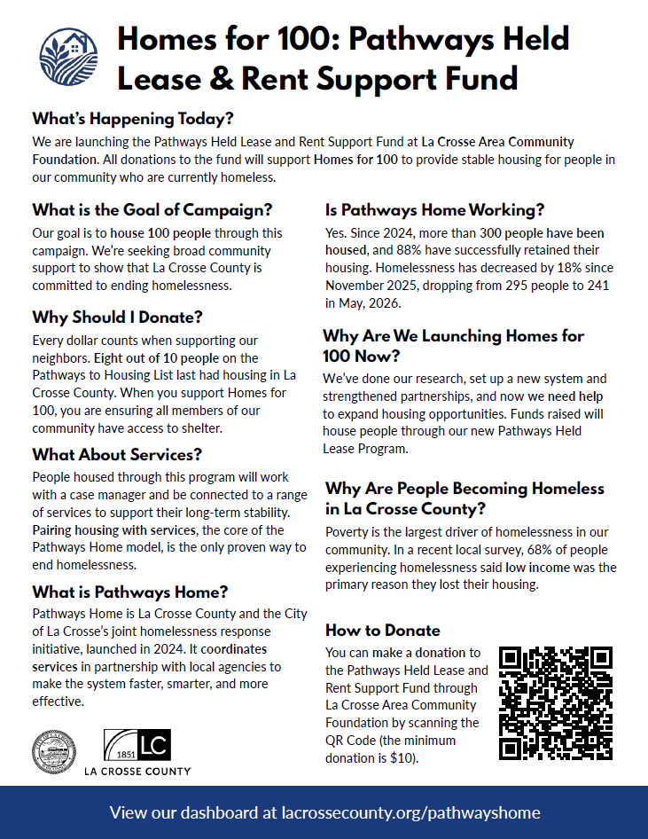
Pathways Held Lease and Rent Support Fund
We have partnered with the La Crosse Area Community Foundation to establish a Pathways Held Lease & Rent Support fund.
La Crosse County & City of La Crosse employees have done an internal campaign.
Notes:
Brian

Slide 20
III. Specialized Housing Plan Update

Slide 21
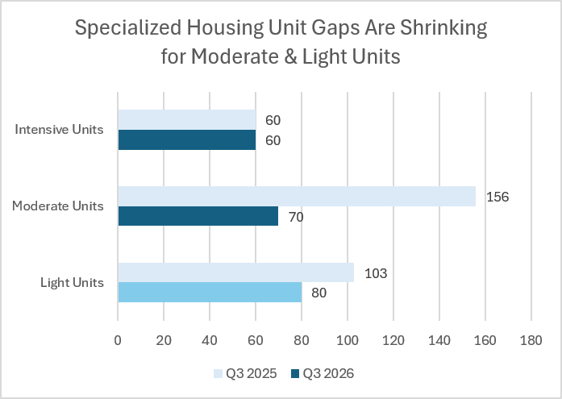
Specialized Housing Plan: 1 Year Update
OUR UNIT GAP
The intensive unit gap remains unchanged at 60 units.
The moderate unit gap has dropped by 86 units to 70 units due to our housing placements and reduced moderate support inflow.
The light unit gap dropped by 23 and is covered by new affordable developments and our Pathways Held Lease program.
In Process
Notes:
Jim
Our housing options don’t adequately match everyone’s needs.

Slide 22
Specialized Housing Gap Closing
Moderate Unit Gap—70 units
Collaborating with Couleecap to maximize impact of ARPA-funds and HUD Permanent Supportive Housing.
Grow coordinated support services so those with moderate needs can be successful in individual units.
Intensive Unit Gap—60 units
Pilot daily intense support (Community Support Program-CSP) in an individual unit.
Expand housing placement in Adult Group Home settings in Wisconsin.
Partner with Medicaid providers for placements in Assisted Living programs.
Notes:
Jim

Slide 23

Pathways
Home
IV. Community Status & Outcomes
Notes:
Brian

Slide 24
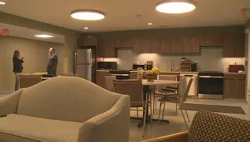
Community Status & Outcomes
Noteworthy
Downtown homelessness is concentrated among people with higher needs
County positions added
Housing added
Overall reduction in homelessness
Park Lane Studios (10 units)
Notes:
Brian
Challenging population in the parks. Stuck with high needs folks.
Overall progress. Getting better at rehousing light and moderate needs folks.
Our community is reducing homelessness. Our greatest remaining challenge is reaching people with the longest histories of homelessness and the most intensive support needs. Sustaining our progress and addressing this gap will require different levels of community investment.

Slide 25
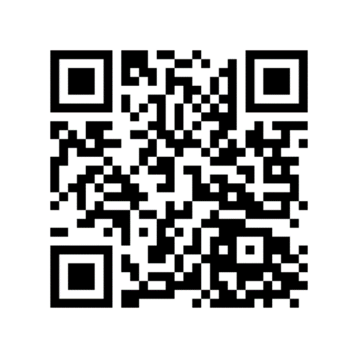
Follow the progress at:
Pathways Home website:
Thank You!
https://lacrossecounty.org/pathwayshome
La Crosse County newsletter:
Notes:
Brian

